Slide 1
DATA PROjet / Business Intelligence
DATA PROjet / Business Intelligence
Anthony LUQUE, ANAIS BANOS, DYLAN CATTELAN, CEDRIC MONTES
CESI EXIA A3
06/07/2018

Slide 2
Points of discussion
2
Situation
Database
Generator
Reporting
Indicators
Dashboard
Axes for improvement
Manufacturing and Conditioning Services
Picking Service
Shipping Service
Notes:
I’ve divided my presentation into 5 parts/sections, They are….

Slide 3
situation
3
Le Palais du Bonbon
ORACLE Database
GENERATOR
Manufacturing
Conditioning
TALEND
ETL
Cloud9Charts
Knowi
IHM BI
Picking
Shipping
MONGODB Database

Slide 4
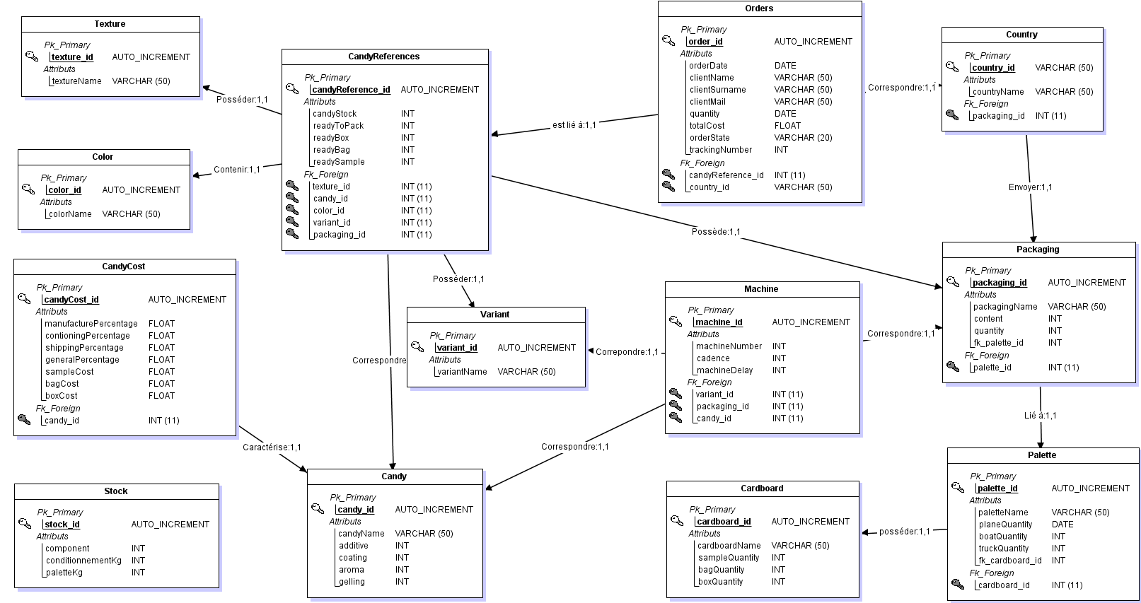
Database – MLD
- Scalability
- Optimization
- Accessibility

Slide 5
generator
GENERATOR
Generates random Orders
Check if References exists
Deals with Component stocks
Calculates Packaging/ Shipping
ORACLE Database

